Slide 1


Does higher quality of education lead to better lacrosse high school lacrosse teams?
An exploration into the correlations between education and lacrosse at the high school level
Timothy Yost
Data Analytics 7: Nashville Software School
Date

Slide 2
Why This Topic?
Does the highs schools rank within the state correlate to the success of their lacrosse team?
How many of the top-ranking schools in education are in the top 10 of best lacrosse team?
Public vs Private in education in each state Do those high performing schools send more students to college on lacrosse scholarships?

Slide 3
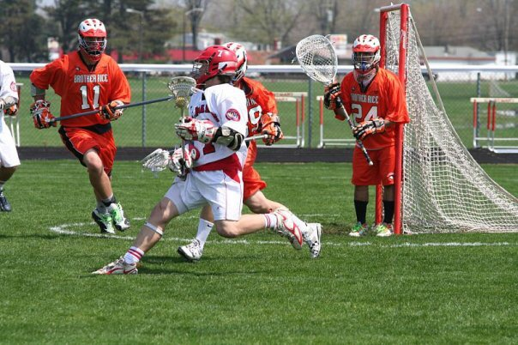
What is Lacrosse?
Lacrosse is an outdoor team sport played with a lacrosse stick and lacrosse ball.
Lacrosse is the oldest organized sport in North America, with its invention in the 12th century by the Indigenous people of North America.
There are four forms of modern lacrosse: field lacrosse with both a male and female version, box lacrosse, and intercrosse. Here we will be focusing on boy’s High school field lacrosse.
Field Lacrosse is played on a large field in a 10v10 format with the object being to put the ball in the opposing net. Men’s lacrosse is a contact sport with similar rules to ice hockey.
The first intercollegiate match was played on November 22, 1877 between New York University and Manhatten College. Today there are 71 Division 1 , 93 Division 2, and 236 Division 3 teams participating in the NCAA.

Slide 4
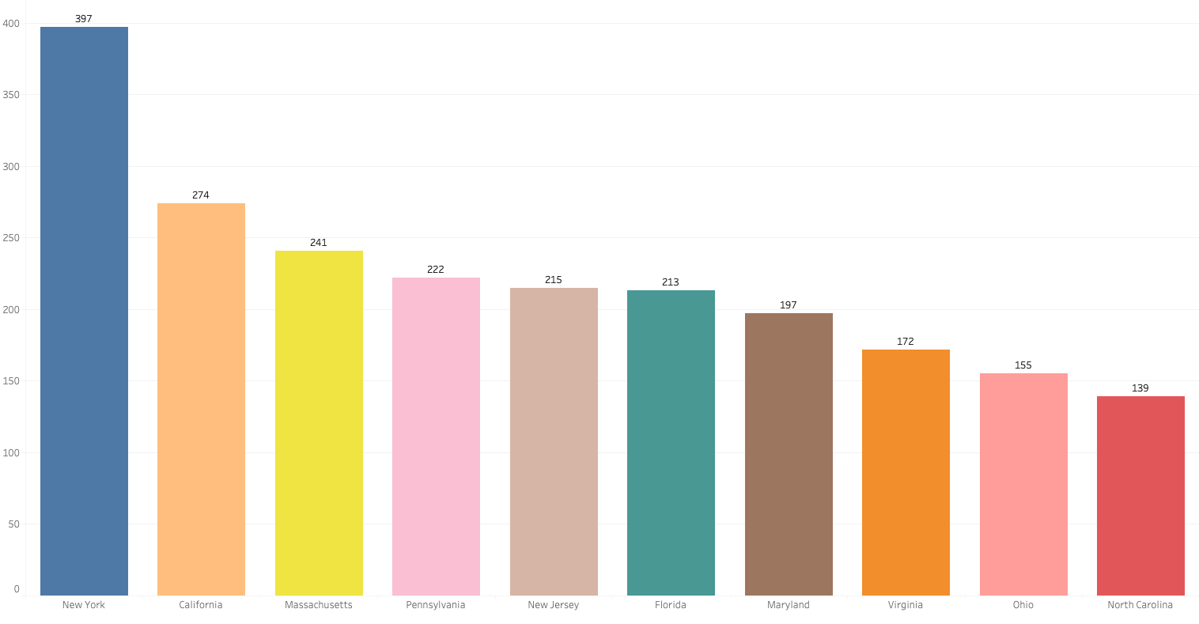
Which States play the most lacrosse?
Top 10 states with the most boys high school teams.

Slide 5
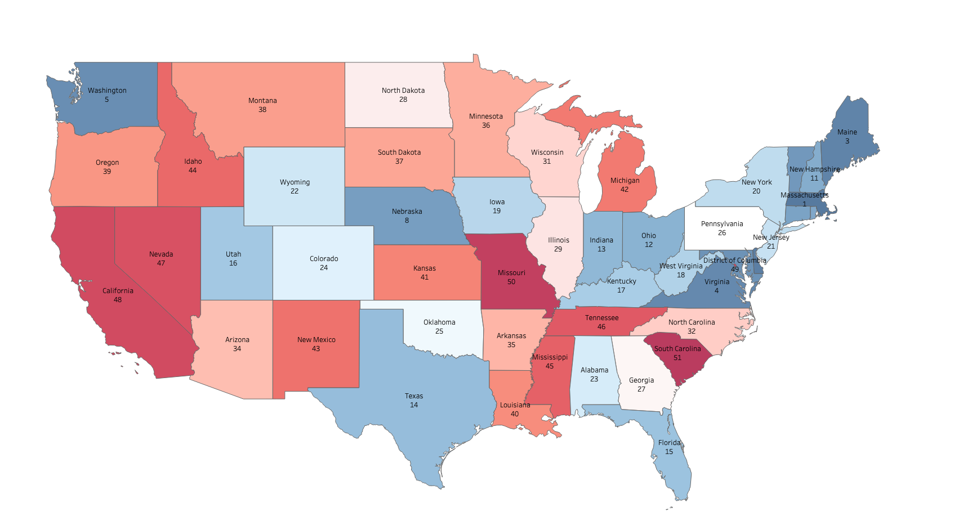
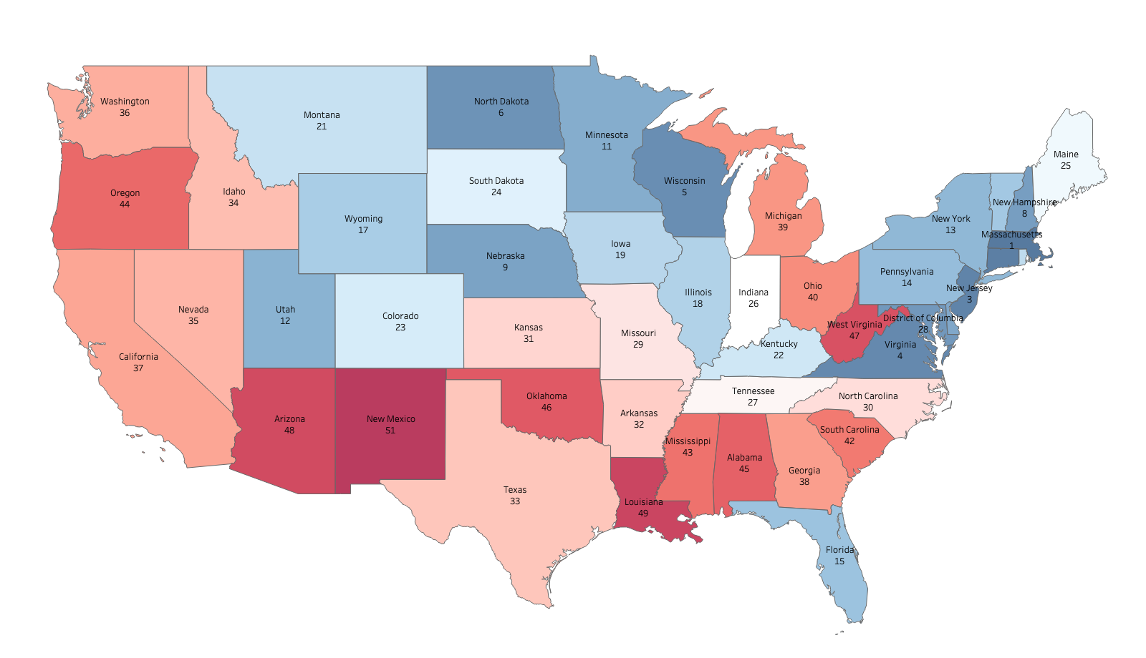
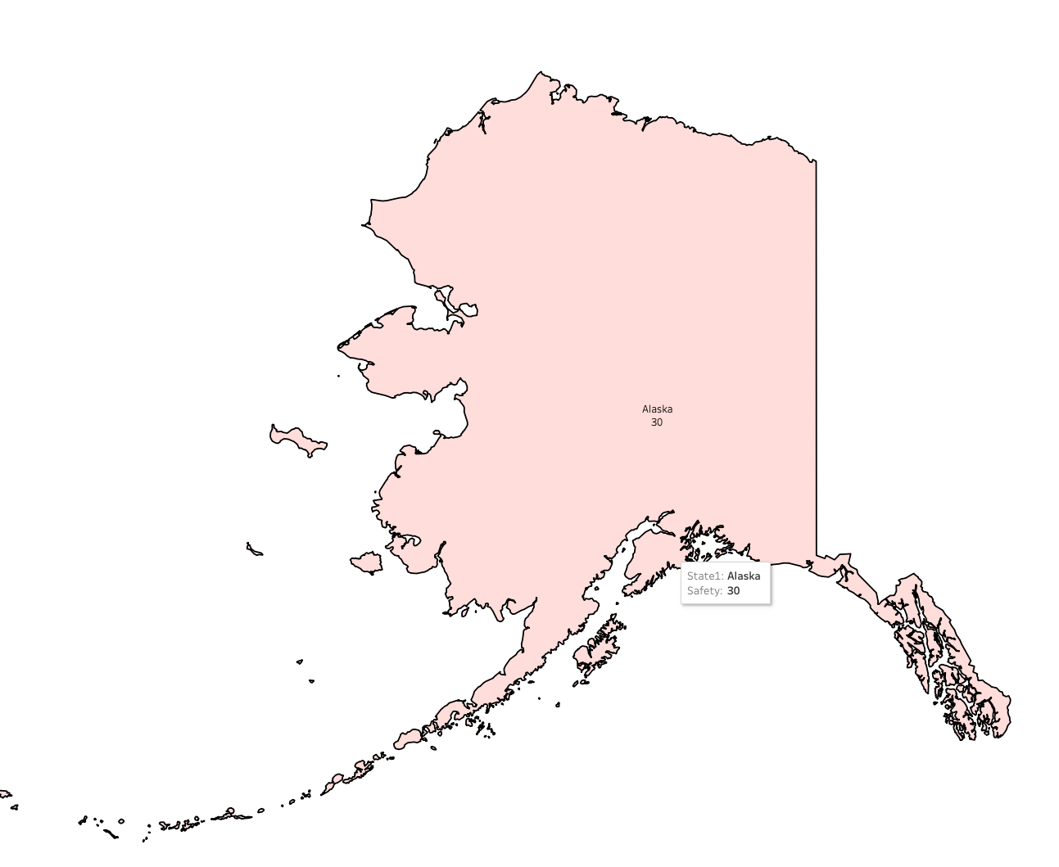



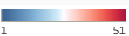
States Ranked by Safety
States Ranked by Quality
30
33
50
41
Safety is calculated
Existence of Digital Learning Plan
State Statute on Out of School access to instructional materials
State Guidance on Accessible Technologies
Share of Threatened/Injured High school Students
Share of High School Students not attending School due to Safety concerns
Share of Children whose parents agree their children go to safe schools
Share of High School Students Participating in Violence
Share of Armed High School Students
Number of School Shootings
School Safety Plan Requirements
Quality is calculated
Presense of Public Schools in the “Top 700 Best U.S. School”
Blue Ribbon Schools Per Capita
High School Graduation Rate Among Low-Income Students
Projected High School Graduation Rate Increase between 2021-2022 and 2022-2033 School Year.
Dropout Rate
Math Test Scores
Reading Test Scores
Median SAT and ACT scores
Pupil-Teacher Rario

Slide 7
Safety is calculated
Existence of Digital Learning Plan
State Statute on Out of School access to instructional materials
State Guidance on Accessible Technologies
Share of Threatened/Injured High school Students
Share of High School Students not attending School due to Safety concerns
Share of Children whose parents agree their children go to safe schools
Share of High School Students Participating in Violence
Share of Armed High School Students
Number of School Shootings
School Safety Plan Requirements
Quality is calculated
Presense of Public Schools in the “Top 700 Best U.S. School”
Blue Ribbon Schools Per Capita
High School Graduation Rate Among Low-Income Students
Projected High School Graduation Rate Increase between 2021-2022 and 2022-2033 School Year.
Dropout Rate
Math Test Scores
Reading Test Scores
Median SAT and ACT scores
Pupil-Teacher Rario

